Slide 1

Noida Institute of Engineering and Technology, Greater Noida
High Performance Computing
Unit: II
Introduction to HPC
Dr. Sonal Dahiya
Associate Professor
Department of AIML
( B Tech 2nd Year)

Slide 2

Faculty Profile
FACULTY PROFILE
Name of Faculty: Dr. Sonal Dahiya
Designation & Department: Associate Professor, AIML
Qualification: B.E, M.Tech, PhD
Experience: 16 Years

Slide 3


Evaluation Scheme
B.Tech. (Computer Science AIML)
Core subject
3rd SEMESTER
PREDICTIVE ANALYTICS

Slide 4

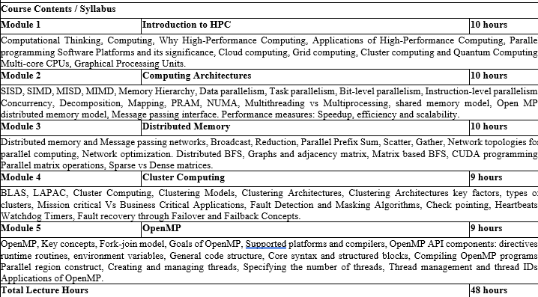
Course Contents / Syllabus

Slide 5
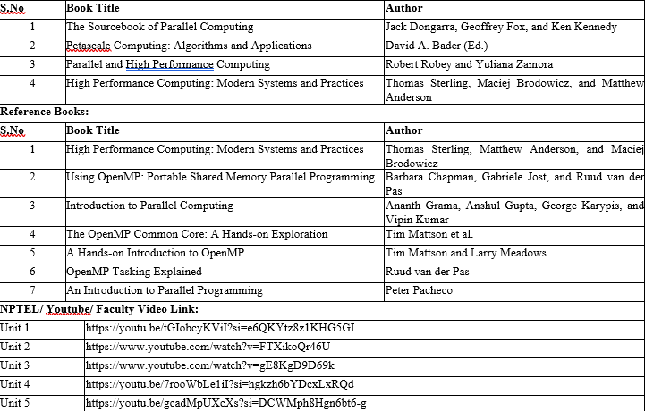
Book Title/ External Links as per Syllabus

Slide 6

Branch wise Applications
Computer science encompasses a diverse array of specialized fields that address modern technological challenges and innovations. Artificial Intelligence (AI) & Machine Learning (ML) empower systems to perceive, learn, and make decisions—from voice assistants and medical diagnostic tools to autonomous vehicles . Data Science & Big Data blend statistics, data modeling, and programming to uncover insights for business intelligence, fraud detection, and predictive analytics. Software Engineering focuses on the full lifecycle of building robust applications—from mobile and web platforms to enterprise and industrial systems . In Cybersecurity & Cryptography, specialists design secure protocols and systems to protect networks, financial infrastructure, and sensitive personal data. Cloud Computing & DevOps enable scalable on-demand services, powering online gaming, streaming, and enterprise applications with automated deployment pipelines . Fields like Computer Graphics & Visualization, Computer Vision, and HCI focus on visual, interactive, and user-centric computing, driving VR/AR, gaming, medical imaging, and intuitive interfaces. Algorithms & Data Structures form the theoretical backbone, optimizing search, encryption, and data retrieval while informing compiler and database design. At the hardware level, Computer Architecture & Embedded Systems support IoT, smart devices, and robotics through efficient design of processors and sensors . Blockchain & Distributed Systems revolutionize secure, decentralized applications in finance and supply chains. Emerging areas like Quantum Computing and Neuromorphic/Biological Computing promise breakthroughs in simulation, optimization, and ultra-efficient intelligent systems—whether using qubits to accelerate drug discovery or neuronal circuits to mimic brain-like computation .

Slide 7
Course Objective
The objective of this course is -
Fundamental HPC Concepts & Terminology Introduce students to essential HPC concepts like parallelism, scaling, and performance (speedup vs. efficiency). Explain why HPC is vital across scientific and engineering domains
Understanding Modern Architectures Cover shared‑memory and distributed systems (clusters, GPUs, accelerators), their architectures, and how hardware design influences software performance.
Mastery of Parallel Programming Models Teach key parallel programming paradigms:
  Shared memory: OpenMP
  Distributed memory: MPI
  Hardware-accelerated: CUDA, OpenCL, OpenACC

Slide 8
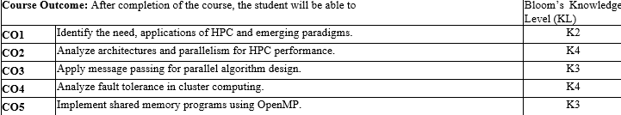

Course Outcomes

Slide 9
Program Outcomes
Engineering Graduates will be able to Understand:
1. Engineering knowledge
2. Problem analysis
3. Design/development of solutions
4. Conduct investigations of complex
5. Modern tool usage
6. The engineer and society
7. Environment and sustainability
8. Ethics
9. Individual and team work
10. Communication
11. Project management and finance
12. Life-long learning

Slide 10
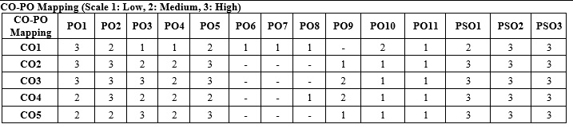
CO-PO Mapping

Slide 11
Program Specific Outcomes (PSOs)
PSO’s
At the end of the program, the student will be able to-
PSO 1: Apply suitable techniques, modern tools to solve complex engineering problems in the field of computer science.
PSO 2: Design and optimize, ethical and innovative solutions for the betterment of the society.
PSO 3: Work as an individual or lead in a team with good communication and engage in life-long learning.

Slide 12
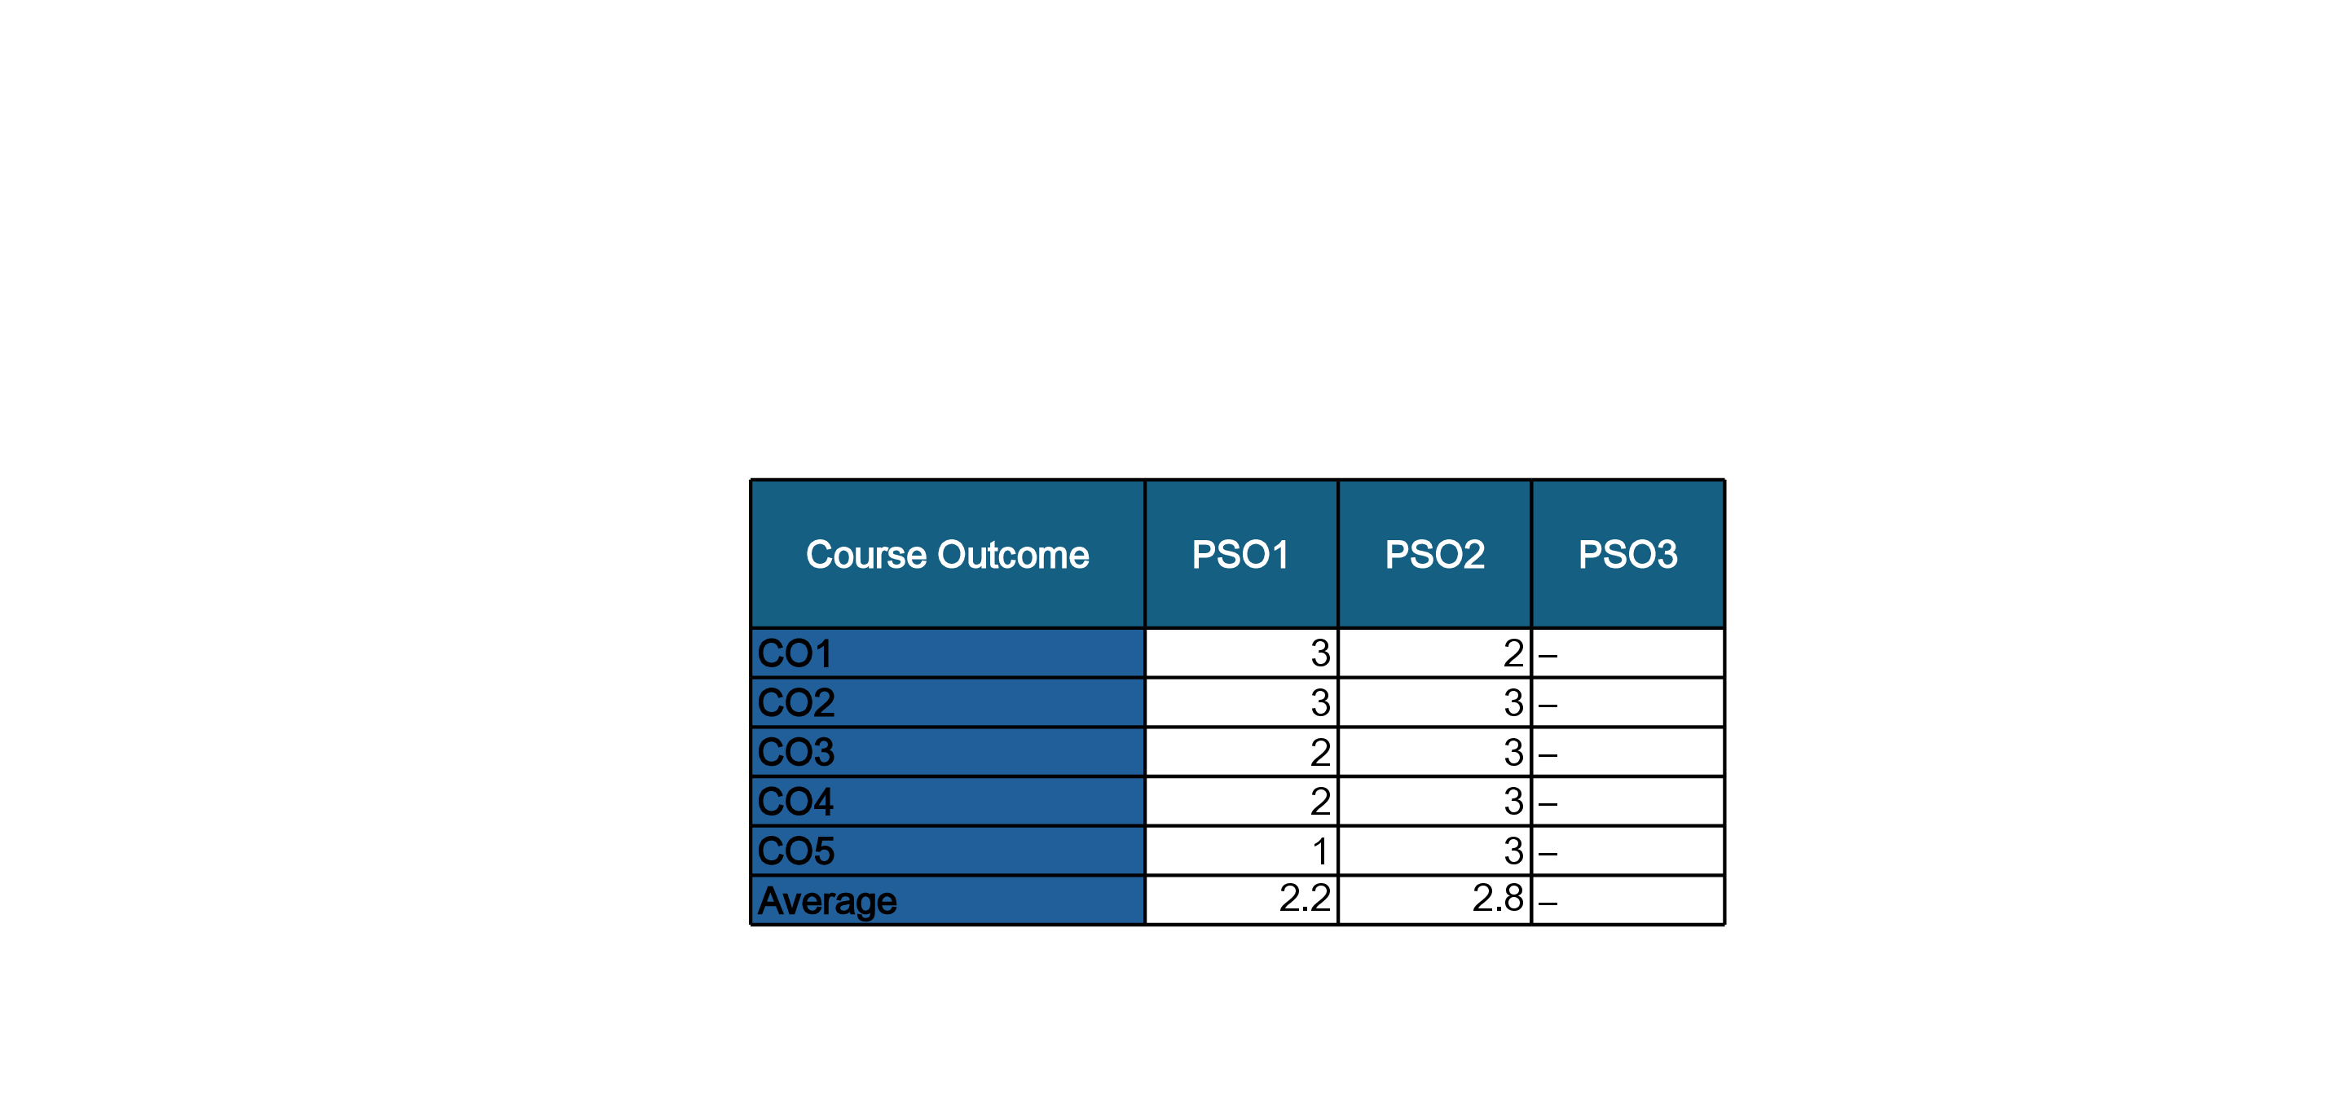
COs and PSOs Mapping

Slide 13
Program Educational Objectives (PEOs)
PEO’s
The graduates of B.Tech Computer Science program will-
PEO1: Have successful careers in the field of Computer Science and pursue higher education.
PEO2: Engage in research and provide innovative solution to real world problems of the society with ethical responsibilities.
PEO3: Demonstrate effective communication, work as an individual or as a team and engage in life-long learning.

Slide 14
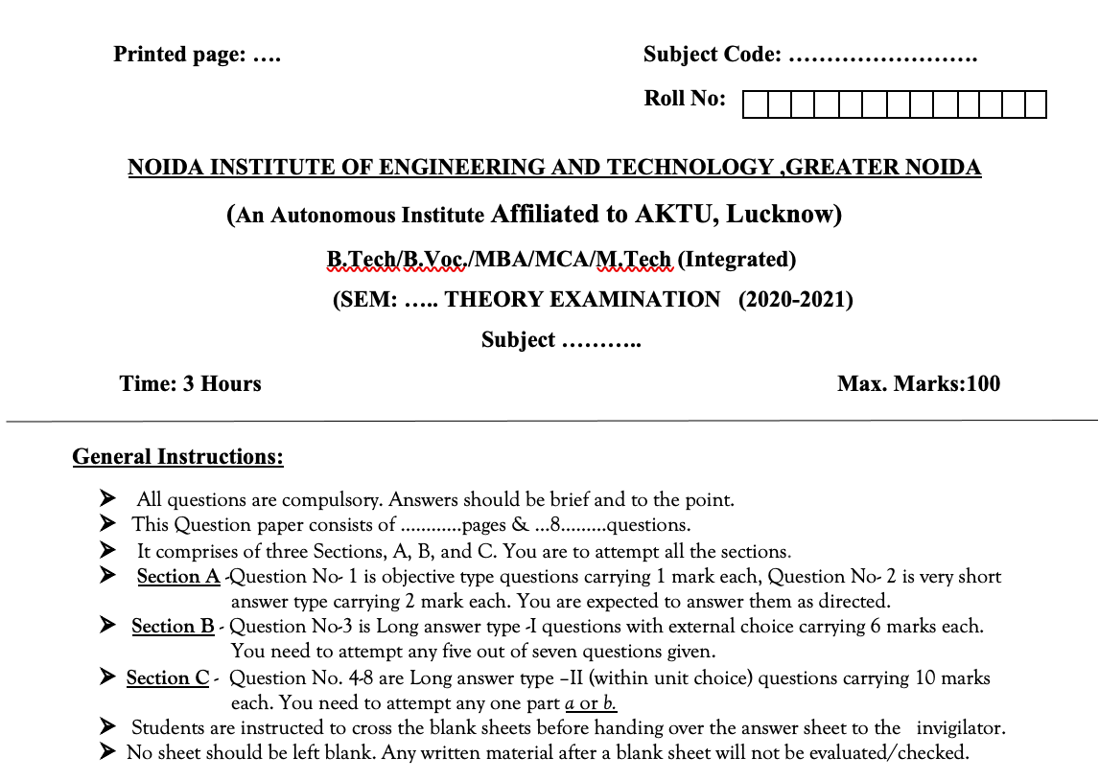
Question Paper Template

Slide 15
Question Paper Template
 |  | SECTION – A |  | CO
 | Attempt all parts- |  | [10×1=10]
 | 1-a. | Question- | (1)
 | 1-b. | Question- | (1)
 | 1-c. | Question- | (1)
 | 1-d. | Question- | (1)
 | 1-e. | Question- | (1)
 | 1-f. | Question- | (1)
 | 1-g. | Question- | (1)
 | 1-h. | Question- | (1)
 | 1-i. | Question- | (1)
 | 1-j. | Question- | (1)
2. | Attempt all parts- |  | [5×2=10] | CO
 | 2-a. | Question- | (2)
 | 2-b. | Question- | (2)
 | 2-c. | Question- | (2)
 | 2-d. | Question- | (2)
 | 2-e. | Question- | (2)
SECTION – B |  |  |  | CO
3. | Answer any five of the following- |  | [5×6=30]
 | 3-a. | Question- | (6)
 | 3-b. | Question- | (6)
 | 3-c. | Question- | (6)
 | 3-d. | Question- | (6)
 | 3-e. | Question- | (6)
 | 3-f. | Question- | (6)
 | 3-g. | Question- | (6)
SECTION – C |  |  |  | CO
4 | Answer any one of the following- |  | [5×10=50]
 | 4-a. | Question- | (10)
 | 4-b. | Question- | (10)
5. | Answer any one of the following-
 | 5-a. | Question- | (10)
 | 5-b. | Question- | (10)
6. | Answer any one of the following-
 | 6-a. | Question- | (10)
 | 6-b. | Question- | (10)
7. | Answer any one of the following-
 | 7-a. | Question- | (10)
 | 7-b. | Question- | (10)
8. | Answer any one of the following-
 | 8-a. | Question- | (10)
 | 8-b. | Question- | (10)

Slide 16
Result Analysis
Subject Result: NA
Department Result: NA
Faculty-Wise Result: NA
High Performance computing Unit 1

Slide 17
Prerequisite and Recap
Prerequisites:
Programming Fundamentals:
Languages: Proficiency in C, C++, or Fortran – essential for working
Recap:
High-Performance Computing, Applications of High-Performance Computing

Slide 18
Brief Intro of Subject with video
High Performance Computing (HPC) focuses on solving complex computational problems using parallel and distributed computing technologies. In today’s era of large-scale data and simulation-driven systems, HPC enables faster processing and analysis by harnessing the power of modern hardware and software tools like multi-core processors, clusters, grids, and even quantum systems.
Students learn:
Core concepts of parallelism
Architectural models like SIMD, MIMD
Programming using OpenMP and MPI
Fault-tolerant mechanisms in cluster systems
This course builds the foundation to design, implement, and analyze performance-driven software and systems used in scientific research, machine learning, big data, etc.

Slide 19

Computational Thinking
Problem-solving method for computer-executable solutions
Components: Decomposition, Pattern Recognition, Abstraction, Algorithms
Fundamental for coding and real-world problem solving

Slide 20
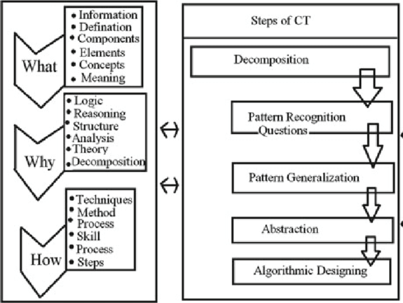
Computational Thinking

Slide 21
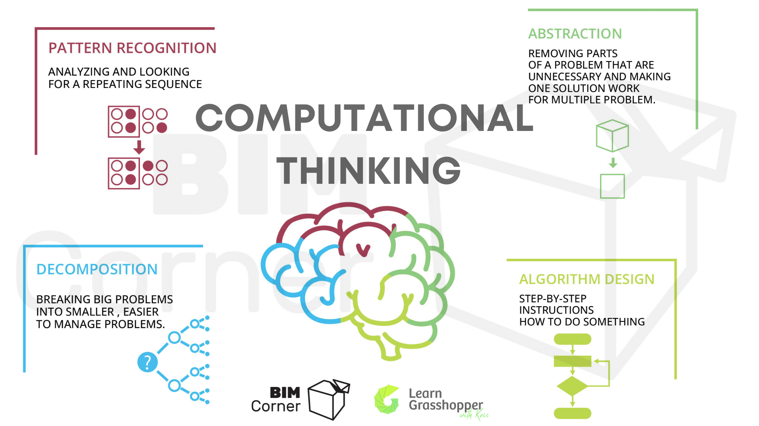
Computational Thinking

Slide 22

What is Computational Thinking?
Asking: What is the power and limit of human and computer intelligence?
Asking: How difficult is the problem?
Asking: How can it be solved?
Asking: How can technology be applied to the problem?
Asking: What computational strategies might be employed?
Notes:
Computational Thinking Presentation
NECC 2007 Atlanta

Slide 23
What it’s not…
It’s not just more technical details for using software
It’s not thinking like a computer
It’s not programming (necessarily)
It doesn’t always require a computer
It’s not yet one more thing to add to your curriculum
Notes:
Computational Thinking Presentation
NECC 2007 Atlanta

Slide 24
Why is it important?
It moves students beyond technology literacy
It creates problem solvers instead of software technicians
It emphasizes creating knowledge rather than using information
It presents endless possibilities for creatively solving problems
It enhances the problem-solving techniques you already teach
Notes:
Computational Thinking Presentation
NECC 2007 Atlanta

Slide 25
What is happening in the World?
“Computational” has become part of
Math and statistics
Every Science
  Biology
  Physics
  Nanotechnology
  Chemistry
  Economics
Arts and recreation
Engineering and design
Notes:
Computational scientists create mathematical models and simulations of physical, biological and chemical phenomena and systems, which allow them to better understand these subjects and predict their behavior. Such research has made computational science a third pillar of science, along with theory and experimentation.
The high-performance computers that make computational science most effective are a new class of complex scientific instruments. To use them well, three disparate elements must be brought together:
Hardware – The electronics and systems that typically are the focus of computer engineering and computer science.
Software – The algorithms – mathematical recipes – applied mathematicians develop algorithms that let computers solve problems.
The sciences, driven by researchers who ask the questions and investigate the problems these powerful instruments probe.
Computational science is the intellectual framework that unites these elements. That’s why most computational science research involves groups of investigators drawn from these areas.
Computational biology – 37,800,000 hits
Physics – 57,000,000
Bioinformatics and computational biology researchers discover and implement algorithms that facilitate the understanding of biological processes through the application of statistical and machine learning techniques in order to better understand cellular processes, --- medicine, human genome,
Computational Thinking Presentation
NECC 2007 Atlanta

Slide 26
What has been accomplished?
Computational
  Physics
  Biology
  Chemistry
  Mathematics
  Computer Science
  Law
  Economics
  Aeronautics
  Education
Notes:
Some of the research computational science has enabled includes:
Physicists unlock secrets of the universe – the big bang – scientists are using powerful computers to simulate accelerator cavity or cell shapes. Simulation lets them test different configurations without the time and expense of actually building them.
Simulating the initial phase of a supernova – the thermonuclear explosion of a star.
Computational Biologist – bioinformaticists - identify enzyme variations and to gain insight into the adaptation of organisms to particular environments. Finding drugs to target specific needs.
Modeling the functions of molecular motors – sub-microscopic protein machines that perform essential tasks in living cells.
Simulating the function of a microbe that produces hydrogen from light energy.
Creating models to predict the flow of contaminants in groundwater.
University of Wisconsin-Madison, is funded by a 3-year, $3.67 million grant from the Department of Energy's Office of Science as part of the Genomics: GTL program. Lead by Prof. Julie Mitchell BACTER will bring a new paradigm of computational biology research and education to bear on the DOE goals of bioremediation and energy production.
Institute in Multiscale Modeling of Biological Interactions (IMMBI) at Johns Hopkins draws on a variety of disciplines in science and engineering to foster studies of biological interactions and to train the next generation of computational biologist
Computational Chemists -- It calculated reactions at each of up to half a billion points in the simulated flame at 120,000 time increments. It tracked 11 different kinds of molecules and 21 different reactions. The simulation generated about 30 terabytes of data – enough to fill the 100-gigabyte hard drives on 300 desktop computers.
Computational CS - Cyber forensics
Computational Lawyers - computational models of reasoning - Stanford
modeling economies -Provides information and resources pertaining to the computational study of economies modeled as evolving systems of autonomous interacting agents…game theory
predicting the weather and the stock market.
Computational thinking is valuable in many areas, from biology to aeronautics. But it is sometimes claimed to be especially valuable in thinking about the human mind.
Computational Thinking Presentation
NECC 2007 Atlanta

Slide 27
Computational Thinking Concepts
Algorithm—the kingpin term
Data—variables, data bases, Queue
Abstraction—conceptualizing, modularizing
Query—search, conditionals, Boolean
Sensing & Feedback—robotics
Iterations—loops, recursion
Systems
Notes:
Let’s take each of these computational terms, many of them derived from computer science, and think about how they fit into your classroom scenario. First a brief definition of each, and an example of how it applies. As we work through the list please think of a situation in your curriculum or classroom environment in which you’ve use the term or could to get students to grow in a computational thinking style. Then I’m going to ask you to ask the person next to you what they do or could do.
Algorithm—set of rules to solve problems..not just a simple recipe. There are vignettes for slightly more complex problems, novels and series of novels for the most complex problems. An important question is to ask “Is this solvable?” and “How exact must the result be to be good enough?”
In a science class you might use this term in organizing some experiment. “let’s create an algorithm for setting up our chlorophyll experiment.” “The class party is coming up. Let’s create an algorithm for getting all of the work completed.”
Data—the information used to solve problems, how it’s organized and how it’s accessed. In social studies “Let’s gather all of the population data we have on the European countries and compile it into a data base. What words should we use to label the fields?” Lining up for lunch becomes a queue. The details for making a decision about planning a class trip become variables …some constants.
Abstraction –(1) pull out the important details and (2) see or generalize the relationship of details to other situations. Math story problems lend themselves to this…abstract the important details. In history class you might lead students through abstract thinking by generalizing the qualities of good leaders. Or in ??
Query—efficient searching for information …drop the word “search” with online searching…learn to use more advanced searches that use conditionals of </>, apply what they have learned in math about Boolean logic with and/or/not logic. Use simple data bases to explore these in any subject.
Sensing—Discussion of handicapped - how do blind people navigate? How is that similar to robotic programming.
Iterations—repeat cycles. In math, iterations occur in long division, In science in the steps of experiments. Questions about “how we know when we are finished” are also part of this.
Systems—large complex group(s) processes – Every lesson needs to be set into the framework of how it is affected by other entities and effects others…Questions about how groups self-organize with decentralized control, migrating birds, kids on the playground, social groups…up to economies and biological systems.
Now I hope everyone has thought of a way to expand or redirect what they do with students to include some computational thinking concepts.
Computational Thinking Presentation
NECC 2007 Atlanta

Slide 28

Computing
Use of computers to process/manage information
Types: Scientific, Business, Embedded, Personal
Trends: AI, Data Analytics, Edge Computing

Slide 29
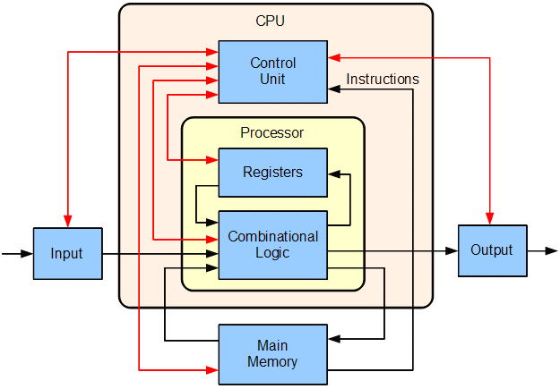
Computing

Slide 30

Why High Performance Computing?
Solves complex problems quickly
Handles massive data efficiently
Benefits: Speed, Scalability, Real-time capability

Slide 31
Benefits
- Faster time to results
- Improved precision and accuracy
- Efficient resource utilization

Slide 32

Applications of HPC
- Scientific Simulations (physics, astronomy)
- Medical Research (genomics, disease models)
- Finance (risk analysis, trading)
- Media (graphics rendering)

Slide 33
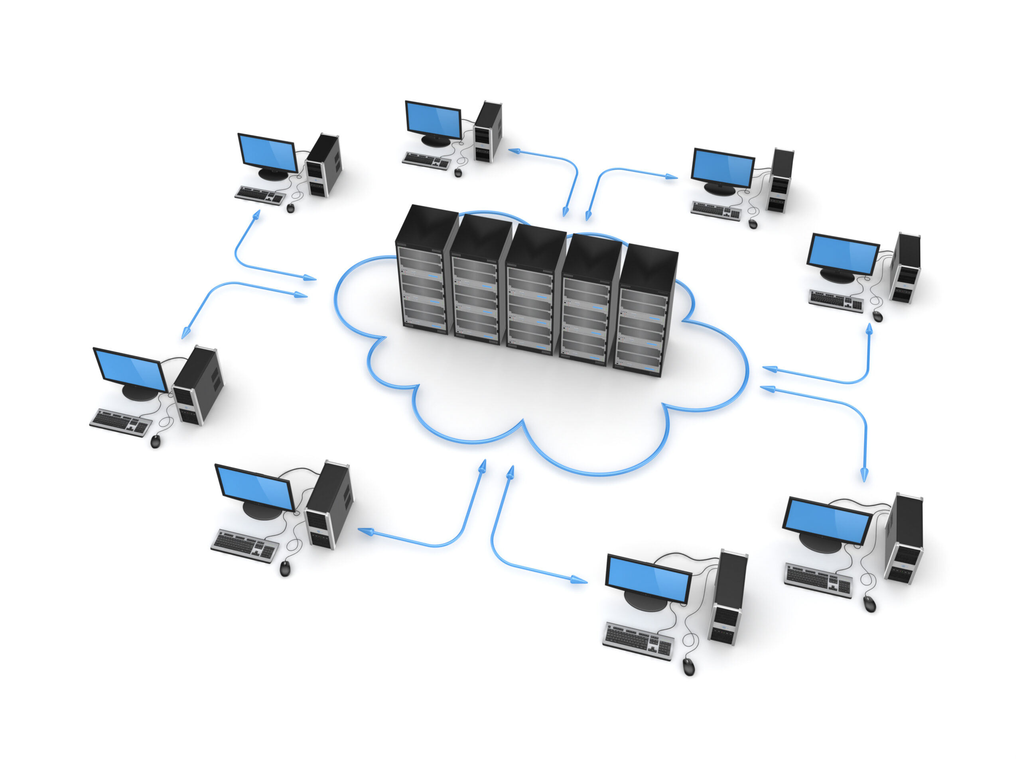
HPC in Industry

Slide 34
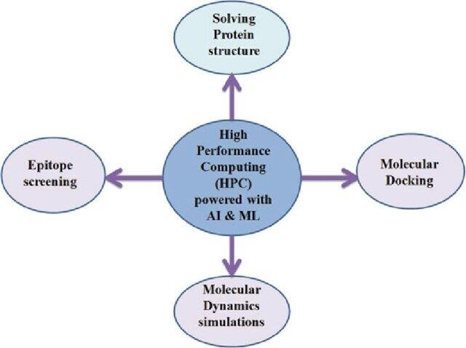
Pandemic & Healthcare AI

Slide 35
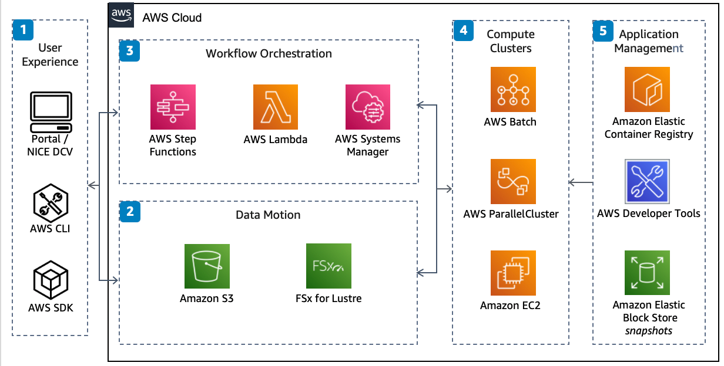
HPC Cloud Workflow

Slide 36
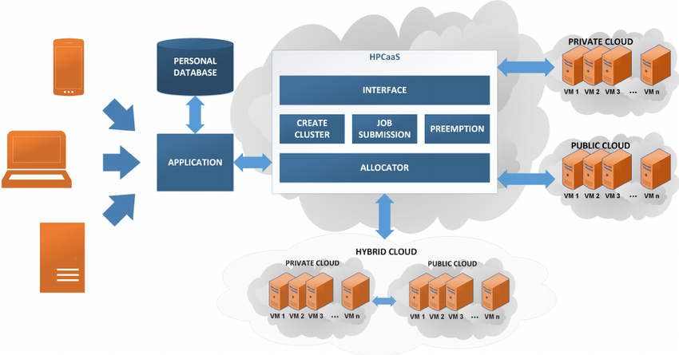
Hybrid/Cloud HPC Platforms

Slide 37
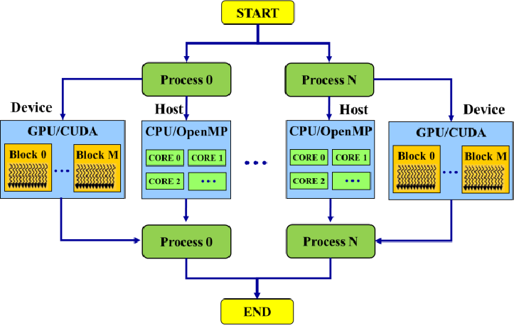
Parallel Programming

Slide 38
Parallel Programming Models
Programming Models
MPI Programming

Slide 39
Fundamental Design Issues
Design of user-system and hardware-software interface
  proposed by Culler et. al.
Functional Issues:
  Naming: how are logically shared data referenced?
  Operations: what operations are provided on shared data?
  Ordering: how are accesses to data ordered and coordinated?
Performance Issues:
  Replication: how are data replicated to reduce communication
  Communication Cost: latency, bandwidth, overhead
Others
  Node granularity

Slide 40
Sequential Programming Model
Functional Issues
  Naming: Can name any variable in virtual address space
    Hardware (and perhaps compilers) does translation to physical addresses
  Operations: Loads and Stores
  Ordering: Sequential program order

Slide 41
Performance
  Rely on dependences on single location (mostly): dependence order
  Compilers and hardware violate other orders without getting caught
  Compiler: reordering and register allocation
  Hardware: out of order, pipeline bypassing, write buffers
  Transparent replication in caches

Slide 42
SAS Programming Model
Processor
Memory
System
Thread
(Process)
Thread
(Process)
read(X)
write(X)
X
Shared variable

Slide 43
Shared Address Space Programming Model
Naming
  Any process can name any variable in shared space
Operations
  Loads and stores, plus those needed for ordering
Simplest Ordering Model
  Within a process/thread: sequential program order
  Across threads: some interleaving (as in time-sharing)
  Additional orders through synchronization
  Again, compilers/hardware can violate orders without getting caught

Slide 44
Synchronization
Mutual exclusion (locks)
  Ensure certain operations on certain data can be performed by only one process at a time
  Room that only one person can enter at a time
  No ordering guarantees
Event synchronization
  Ordering of events to preserve dependences
  e.g. producer —> consumer of data
  3 main types:
    point-to-point
    global
    group

Slide 45
MP Programming Model
Processor
Memory
Node A
Node B
process
process
send (Y)
receive (Y’)
Y
Y’
message

Slide 46
Message Passing Programming Model
Naming
  Processes can name private data directly.
  No shared address space
Operations
  Explicit communication: “send” and “receive”
  “Send” transfers data from private address space to another process
  “Receive” copies data from process to private address space

Slide 47
Ordering
  Program order within a process
  Send and receive can provide pt-to-pt synch between processes
  Mutual exclusion inherent
Can construct global address space
  Process number + address within process address space
  But no direct operations on these names

Slide 48
Parallel Programming Software Platforms
Parallel Programming
- Programs run on multiple processors simultaneously
- Platforms: OpenMP, MPI, CUDA, Intel TBB
- Enables faster and efficient computing

Slide 49
Cloud Computing
Cloud Computing
- Internet-based on demand access to computing services
- Types: IaaS, PaaS, SaaS
- Advantages: Scalable, Cost-effective, Accessible, Speedy& Agile
- Examples: AWS, Azure, GCP

Slide 50
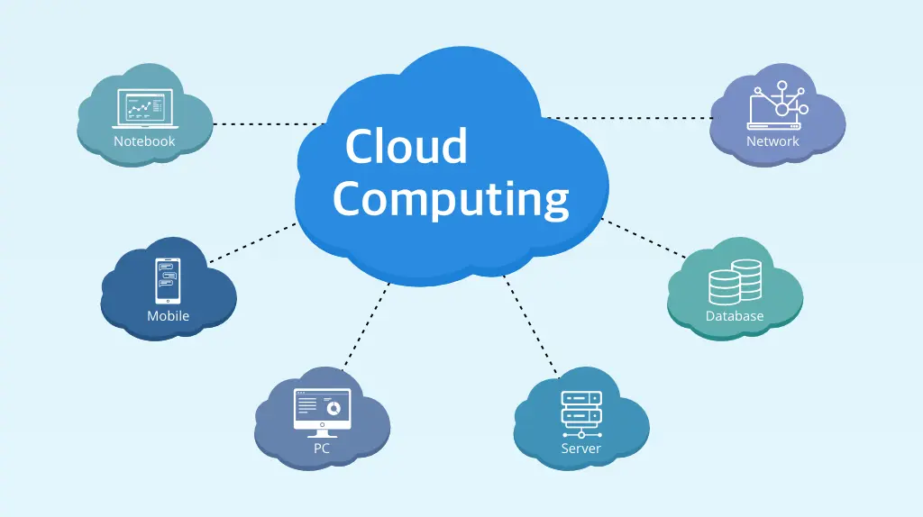

Slide 51
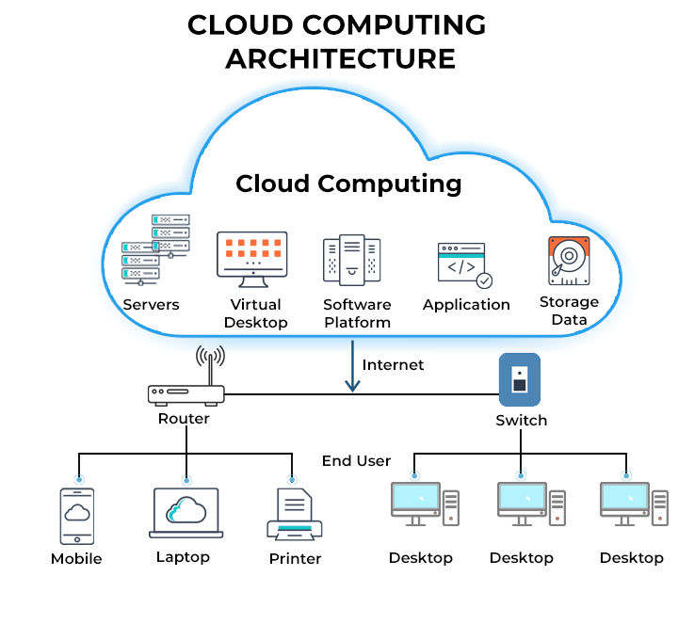

Slide 52

Grid Computing
- Distributed computing across multiple locations
- Features: Heterogeneous systems, Shared workloads
- Used in scientific research and large data tasks

Slide 53
What is a Grid?
Many definitions exist in the literature
Early defs: Foster and Kesselman, 1998
  “A computational grid is a hardware and software infrastructure that provides dependable, consistent, pervasive, and inexpensive access to high-end computational facilities”
Kleinrock 1969:
  “We will probably see the spread of ‘computer utilities’, which, like present electric and telephone utilities, will service individual homes and offices across the country.”

Slide 54

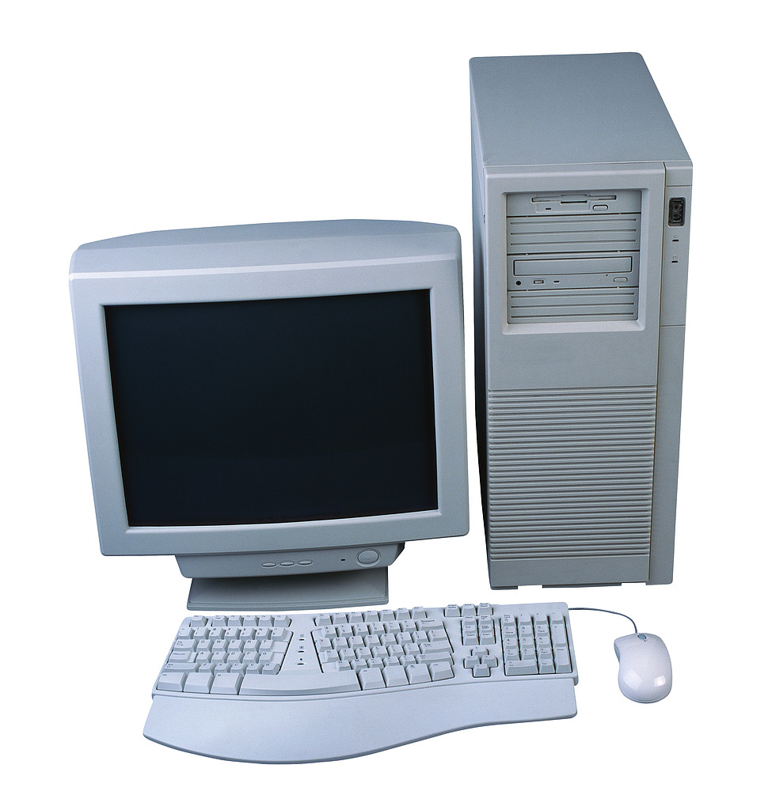
Grid Architecture
Autonomous, globally distributed computers/clusters

Slide 55
Why do we need Grids?
Many large-scale problems cannot be solved by a single computer
Globally distributed data and resources

Slide 56
Background: Related technologies
Cluster computing
Peer-to-peer computing
Internet computing

Slide 57
Cluster computing
Idea: put some PCs together and get them to communicate
Cheaper to build than a mainframe supercomputer
Different sizes of clusters
Scalable – can grow a cluster by adding more PCs

Slide 58
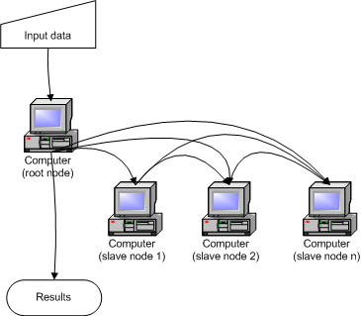
Cluster Architecture

Slide 59
Peer-to-Peer computing
Connect to other computers
Can access files from any computer on the network
Allows data sharing without going through central server
Decentralized approach also useful for Grid

Slide 60
Peer to Peer architecture

Slide 61
Internet computing
Idea: many idle PCs on the Internet
Can perform other computations while not being used
“Cycle scavenging” – rely on getting free time on other people’s computers
Example: SETI@home
What are advantages/disadvantages of cycle scavenging?

Slide 62
Some Grid Applications
Distributed supercomputing
High-throughput computing
On-demand computing
Data-intensive computing
Collaborative computing

Slide 63
Distributed Supercomputing
Idea: aggregate computational resources to tackle problems that cannot be solved by a single system
Examples: climate modeling, computational chemistry
Challenges include:
  Scheduling scarce and expensive resources
  Scalability of protocols and algorithms
  Maintaining high levels of performance across heterogeneous systems

Slide 64
High-throughput computing
Schedule large numbers of independent tasks
Goal: exploit unused CPU cycles (e.g., from idle workstations)
Unlike distributed computing, tasks loosely coupled
Examples: parameter studies, cryptographic problems

Slide 65
On-demand computing
Use Grid capabilities to meet short-term requirements for resources that cannot conveniently be located locally
Unlike distributed computing, driven by cost-performance concerns rather than absolute performance
Dispatch expensive or specialized computations to remote servers

Slide 66
Data-intensive computing
Synthesize data in geographically distributed repositories
Synthesis may be computationally and communication intensive
Examples:
  High energy physics generate terabytes of distributed data, need complex queries to detect “interesting” events
  Distributed analysis of Sloan Digital Sky Survey data

Slide 67
Collaborative computing
Enable shared use of data archives and simulations
Examples:
  Collaborative exploration of large geophysical data sets
Challenges:
  Real-time demands of interactive applications
  Rich variety of interactions

Slide 68
Grid Communities
Who will use Grids?
Broad view
  Benefits of sharing outweigh costs
  Universal, like a power Grid
Narrow view
  Cost of sharing across institutional boundaries is too high
  Resources only shared when incentive to do so
  Grid will be specialized to support specific communities with specific goals

Slide 69
Grid Users
Many levels of users
  Grid developers
  Tool developers
  Application developers
  End users
  System administrators

Slide 70
Some Grid challenges
Data movement
Data replication
Resource management
Job submission

Slide 71
Cluster Computing
Cluster Copmuting
- Linked computers work as a single unit
- Types: Load-balancing, High-availability, HPC clusters
- Centralized management, Fault tolerance

Slide 72

Quantum Computing
- Uses qubits based on quantum mechanics
- Concepts: Superposition, Entanglement
- Applications: Cryptography, Drug discovery
- Emerging technology

Slide 73
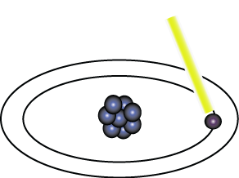
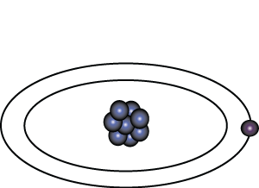
Representation of Data - Qubits
A bit of data is represented by a single atom that is in one of two states denoted by |0> and |1>. A single bit of this form is known as a qubit
A physical implementation of a qubit could use the two energy levels of an atom. An excited state representing |1> and a ground state representing |0>.
Light pulse of frequency λ for time interval t
Excited State
Ground State
Nucleus
Electron
State |0>
State |1>

Slide 74
Representation of Data - Superposition
A single qubit can be forced into a superposition of the two states denoted by the addition of the state vectors:
|ψ> = α |0> + α |1>
Where α and α are complex numbers and |α | + | α | = 1
1
2
2
2
1
2
1
2
A qubit in superposition is in both of the states |1> and |0 at the same time

Slide 75
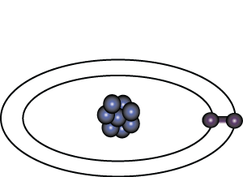
Representation of Data - Superposition
Light pulse of frequency λ for time interval t/2
State |0>
State |0> + |1>
Consider a 3 bit qubit register. An equally weighted superposition of all possible states would be denoted by:
|ψ> = |000> + |001> + . . . + |111>
1
1
1
√8
√8
√8

Slide 76
Data Retrieval
In general, an n qubit register can represent the numbers 0 through 2^n-1 simultaneously.
Sound too good to be true?…It is!
If we attempt to retrieve the values represented within a superposition, the superposition randomly collapses to represent just one of the original values.
In our equation: |ψ> = α |0> + α |1> , α represents the probability of the superposition collapsing to |0>. The α’s are called probability amplitudes. In a balanced superposition, α = 1/√2 where n is the number of qubits.
1
2
1
n

Slide 77
Relationships among data - Entanglement
Entanglement is the ability of quantum systems to exhibit correlations between states within a superposition.
Imagine two qubits, each in the state |0> + |1> (a superposition of the 0 and 1.) We can entangle the two qubits such that the measurement of one qubit is always correlated to the measurement of the other qubit.

Slide 78
Multi-Core CPU
- CPUs with multiple processing cores
- Enhances multitasking and parallel execution
- Common in laptops, servers, smartphones

Slide 79
Graphical Processing Units (GPUs)
GPU
- Specialized processors for image and data acceleration
- Many small cores, ideal for parallelism
- Used in AI, gaming, simulations
- Examples: NVIDIA, AMD

Slide 80
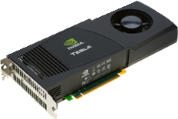
GPGPU
“General purpose graphics processing unit”
  Harness GPU shader cores for general computation
  Poor name: oxymoron
History
  GPU shader cores provide increasing FP computation throughput
  Only accessible through graphic device driver (e.g. DirectX/OpenGL)
  Early 2000’s “hackers” learn to write programs
  Mid 2000’s Nvidia decides to create CUDA framework
  ATI follows with OpenCL
Compute Unified Device Architecture == CUDA
  Heavily-multithreaded multiprocessor, NCC-UMA (sort of)
  Software toolkit: C-like source/APIs => PTX binary

Slide 81
Speedup of Applications
GeForce 8800 GTX vs. 2.2GHz Opteron 248
10× speedup in a kernel is typical, as long as the kernel can occupy enough parallel threads
25× to 400× speedup if the function’s data requirements and control flow suit the GPU and the application is optimized
Keep in mind that the speedup also reflects how suitable the CPU is for executing the kernel
© David Kirk/NVIDIA and Wen-mei W. Hwu, 2007
ECE 498AL, University of Illinois, Urbana-Champaign
Notes:
All kernels have large numbers of simultaneously executing threads (ask me if you want to see details).
Most of the 10X kernels saturate memory bandwidth

Slide 82
Single-Program Multiple-Data (SPMD)
CUDA integrated CPU + GPU application C program
  Serial C code executes on CPU
  Parallel Kernel C code executes on GPU thread blocks
CPU Serial Code
Grid 0
GPU Parallel Kernel
KernelA<<< nBlk, nTid >>>(args);
. . .
CPU Serial Code
Grid 1
GPU Parallel Kernel
KernelB<<< nBlk, nTid >>>(args);
. . .

Slide 83
Grids and Blocks
A kernel is executed as a grid of thread blocks
  All threads share data memory space
A thread block is a batch of threads that can cooperate with each other by:
  Synchronizing their execution
    For hazard-free shared memory accesses
  Efficiently sharing data through a low latency shared memory
  Two threads from two different blocks cannot cooperate
Host
Device
Grid 1
Kernel 1
Block
(0, 0)
Block
(1, 0)
Block
(2, 0)
Block
(0, 1)
Block
(1, 1)
Block
(2, 1)
Grid 2
Kernel 2
Block (1, 1)
Thread
(0, 0)
Thread
(1, 0)
Thread
(2, 0)
Thread
(3, 0)
Thread
(4, 0)
Thread
(0, 1)
Thread
(1, 1)
Thread
(2, 1)
Thread
(3, 1)
Thread
(4, 1)
Thread
(0, 2)
Thread
(1, 2)
Thread
(2, 2)
Thread
(3, 2)
Thread
(4, 2)
Courtesy: NVIDIA

Slide 84
CUDA Thread Block
Programmer declares (Thread) Block:
  Block size 1 to 512 concurrent threads
  Block shape 1D, 2D, or 3D
  Block dimensions in threads
All threads in a Block execute the same thread program
Threads have thread id numbers within Block
Threads share data and synchronize while doing their share of the work
Thread program uses thread id to select work and address shared data
CUDA Thread Block
Thread Id #:
0 1 2 3 … m
Thread program
Courtesy: John Nickolls, NVIDIA

Slide 85
CUDA Processor Terminology
SPA
  Streaming Processor Array (variable across GeForce 8-series, 8 in GeForce8800)
TPC
  Texture Processor Cluster (2 SM + TEX)
SM
  Streaming Multiprocessor (8 SP)
  Multi-threaded processor core
  Fundamental processing unit for CUDA thread block
SP
  Streaming Processor
  Scalar ALU for a single CUDA thread

Slide 86
CUDA Device Memory
Each thread can:
  R/W per-thread registers
  R/W per-thread local memory
  R/W per-block shared memory
  R/W per-grid global memory
  Read only per-grid constant memory
  Read only per-grid texture memory
(Device) Grid
Block (0, 0)
Block (1, 0)
Shared Memory
Shared Memory
Registers
Registers
Registers
Registers
Thread (0, 0)
Thread (1, 0)
Thread (0, 0)
Thread (1, 0)
Local
Memory
Local
Memory
Local
Memory
Local
Memory
The host can R/W global, constant, and texture memories
Host
Global
Memory
Constant
Memory
Texture
Memory
Notes:
Global, constant, and texture memory spaces are persistent across kernels called by the same application.

Slide 87
Parallel Memory Sharing
Thread
Local Memory: per-thread
  Private per thread
  Auto variables, register spill
Shared Memory: per-Block
  Shared by threads of the same block
  Inter-thread communication
Global Memory: per-application
  Shared by all threads
  Inter-Grid communication
Local Memory
Block
Shared
Memory
Grid 0
Global
Memory
. . .
Sequential
Grids
in Time
Grid 1
. . .

Slide 88
CUDA Programming Model:
A Highly Multithreaded Coprocessor
The GPU is viewed as a compute device that:
  Is a coprocessor to the CPU or host
  Has its own DRAM (device memory)
  Runs many threads in parallel
Data-parallel portions of an application are executed on the device as kernels which run in parallel on many threads
Differences between GPU and CPU threads
  GPU threads are extremely lightweight
    Very little creation overhead
  GPU needs 1000s of threads for full efficiency
    Multi-core CPU needs only a few

Slide 89
Block and Thread IDs
Threads and blocks have IDs
  So each thread can decide what data to work on
  Block ID: 1D or 2D
  Thread ID: 1D, 2D, or 3D
Simplifies memory
addressing when processing
multidimensional data
  Image processing
  Solving PDEs on volumes
  …
Device
Grid 1
Block
(0, 0)
Block
(1, 0)
Block
(2, 0)
Block
(0, 1)
Block
(1, 1)
Block
(2, 1)
Block (1, 1)
Thread
(0, 0)
Thread
(1, 0)
Thread
(2, 0)
Thread
(3, 0)
Thread
(4, 0)
Thread
(0, 1)
Thread
(1, 1)
Thread
(2, 1)
Thread
(3, 1)
Thread
(4, 1)
Thread
(0, 2)
Thread
(1, 2)
Thread
(2, 2)
Thread
(3, 2)
Thread
(4, 2)
Courtesy: NDVIA

Slide 90
Refrences
1. Cuny, J., Snyder, L., & Wing, J. M. (2010). Demystifying Computational Thinking. Carnegie Mellon University.
2. Wing, J. M. (2006). Computational Thinking. Communications of the ACM, 49(3), 33-35.
3. Leeds ARC. HPC System Architecture Overview. https://arcdocs.leeds.ac.uk
4. PhoenixNAP. High Performance Computing Architecture. https://phoenixnap.com/kb/hpc-architecture
5. Weka.io. HPC Applications. https://www.weka.io/learn/hpc/hpc-applications/
6. AWS. High Performance Computing on AWS. https://docs.aws.amazon.com
7. ResearchGate. HPC in COVID-19 Drug Discovery. https://www.researchgate.net/
8. NVIDIA. Introduction to CUDA-Aware MPI. https://developer.nvidia.com/blog/introduction-cuda-aware-mpi/
9. ResearchGate. Hybrid MPI + OpenMP + CUDA Model. https://www.researchgate.net/
10. MDPI. Parallel Programming Task Models. https://www.mdpi.com/2076-3417/13/21/11960
11. StackScale. Cloud Service Models. https://www.stackscale.com/blog/cloud-service-models/
12. ResearchGate. Cloud Architecture Diagrams. https://www.researchgate.net/
13. GeeksforGeeks. Cloud Deployment Models. https://www.geeksforgeeks.org/cloud-computing-deployment-models/
14. NVIDIA. CUDA GPU Architecture Diagram. https://developer.nvidia.com/
15. Wikipedia Commons. GPU vs CPU Parallelism. https://commons.wikimedia.org/

Slide 91
Recap
Computational Thinking: Problem decomposition, pattern recognition, abstraction, and algorithm design.
Computing: Fundamentals of computer systems, types of computing models.
High Performance Computing (HPC): Need, architecture, and applications in science, AI, and engineering.
Parallel Programming: Introduction to MPI, OpenMP, CUDA, and hybrid parallelism models.
Cloud Computing: IaaS, PaaS, SaaS models and cloud deployment types.
Grid and Cluster Computing: Resource pooling across distributed systems.
Quantum Computing: Basics of qubits, superposition, and quantum speedup.
Multi-core CPUs & GPUs: Role in accelerating computationally heavy workloads.

Slide 92
Thank You

